Slide 1
MRA Project ML 1
Rushikesh S. Kalkar
PGP-DSBA-Online dec_a 2021
September 2022

Slide 2
Contents of Slide
Executive Summary
Problem Statement
Assumption
About Data
Data Dictionary
Head and Tail of Data
Info of Data
Summary Statistics
EDA
EDA Univariate
EDA Bivariate
EDA Multivariate
Trends
Yearly
Quarterly
Monthly
Weekly
Weekday
EDA Summary and Inference
RFM
Customer Segmentation using RFM
KNIME Workflow
RFM Output Table Head
Inferences from RFM Analysis and identified segments
Top 5 Best Customers
Top 5 Loyal Customers
Customers on the Verge of Churning
Lost Inactive Customers
New Customers

Slide 3
Executive SUMMARY
This project aims to find the underlying buying patterns of the customers of an automobile part manufacturer based on the past 3 years of the Company's transaction data and hence recommend customized marketing strategies for different segments of customers.

Slide 4
PROBLEM STATEMENT
An automobile parts manufacturing company has collected data of transactions for 3 years. They do not have any in-house data science team, thus they have hired you as their consultant. Your job is to use your magical data science skills to provide them with suitable insights about their data and their customers.

Slide 5
ASSUMPTION
Variable named “DAYS_SINCE_LASTORDER” has been renamed as Recency
As mentioned in the FAQs Max Order Date and that may be "30-05-2020" or "01-06-2020“ The difference between order date and Max date does give us the Recency.
The Variable name ‘ORDER_NO’ and ‘ORDER_LINE_NO’ have transformed to categorical type, as they makes more sense in that format

Slide 6
About data
The dataset consist of 2747 rows and 20 columns.
The data has datetime64[ns](1), float64(2), int64(5), object(12) datatypes.
No null values are present in the dataset
No duplicates are present in the data.

Slide 7
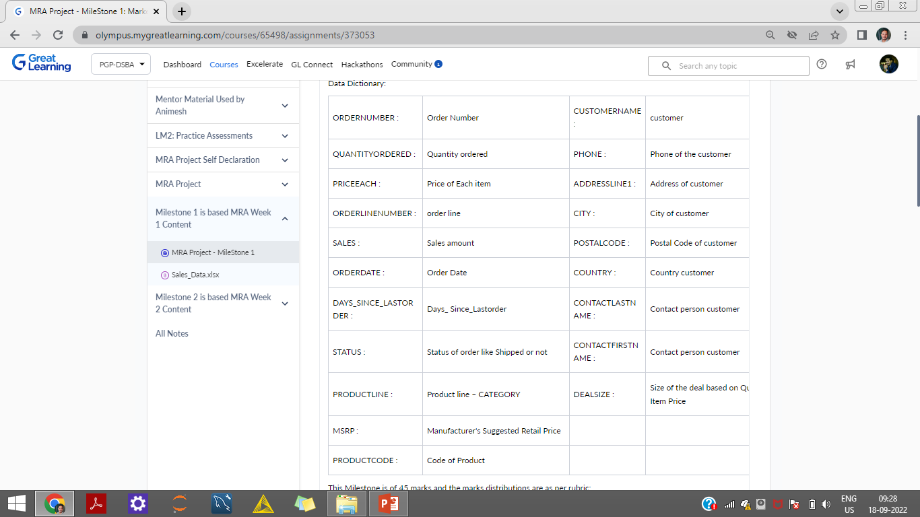
Data Dictionary

Slide 8
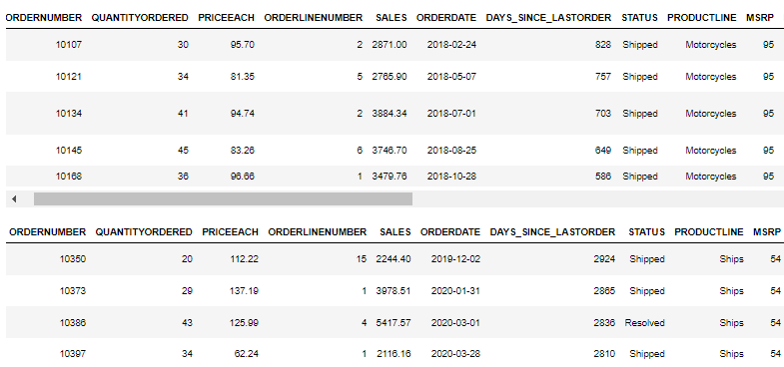
Head and Tail of data

Slide 9
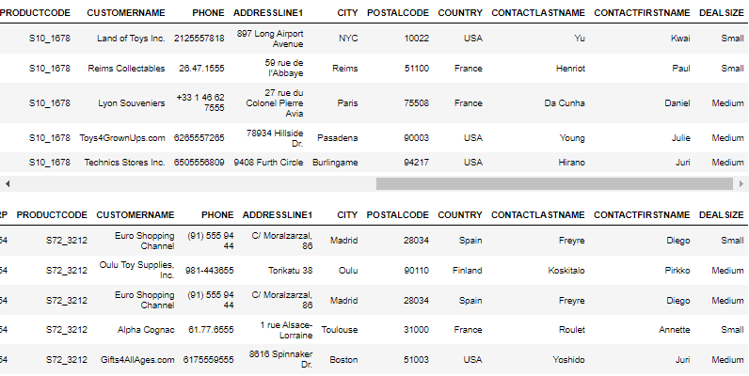
Head and Tail of data

Slide 10
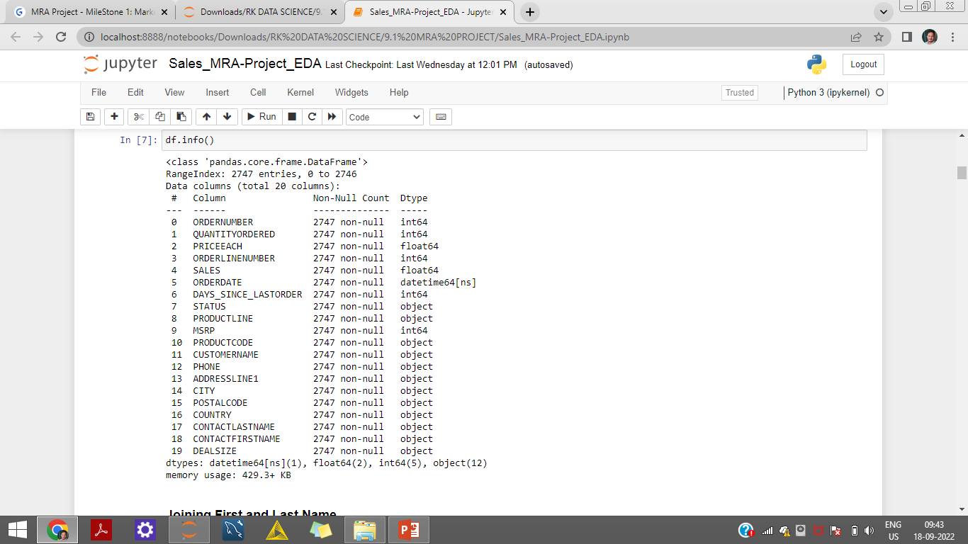
Info of data

Slide 11
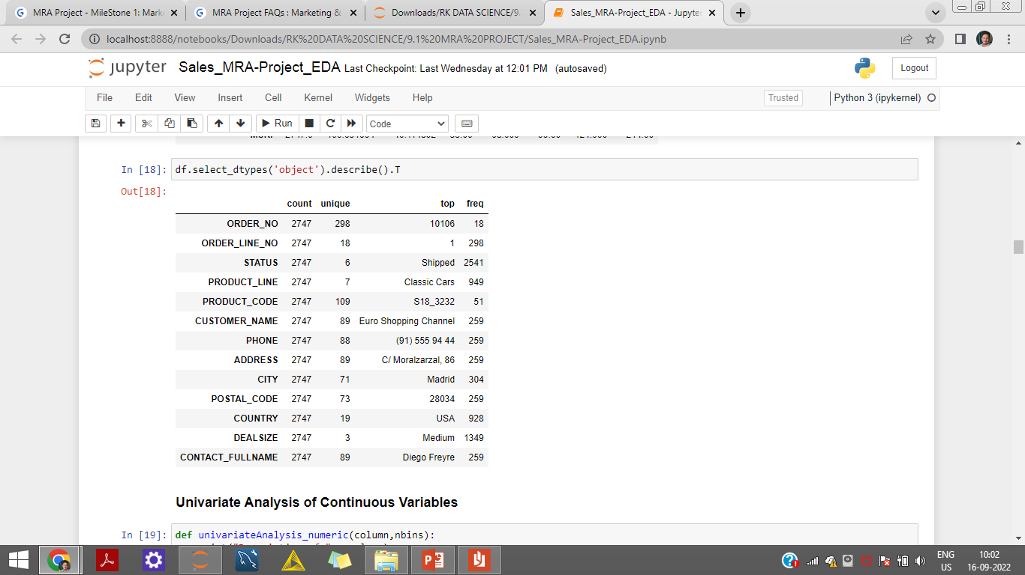
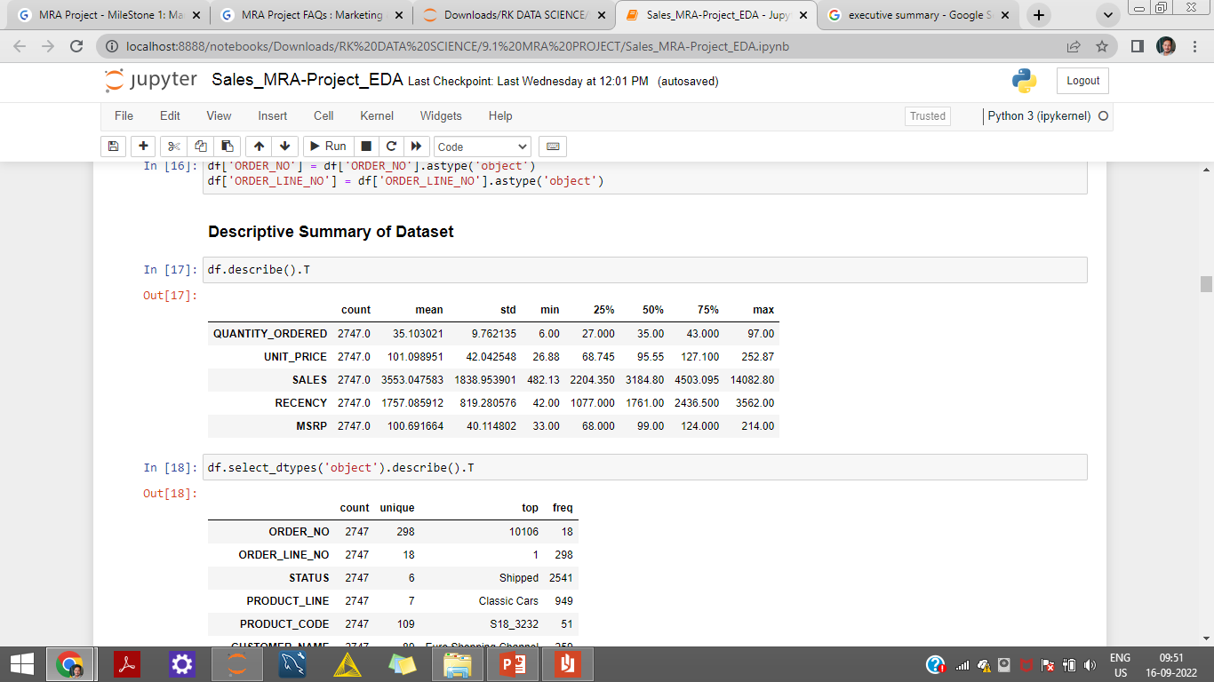
Summary Statistics
Descriptive Summary of the Dataset Numeric
Descriptive Summary of the Dataset Categorical

Slide 12
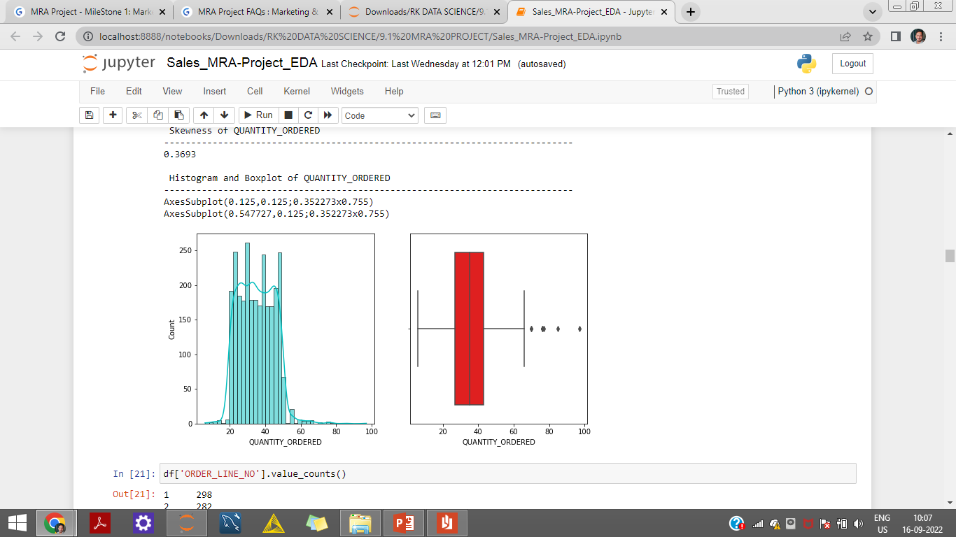
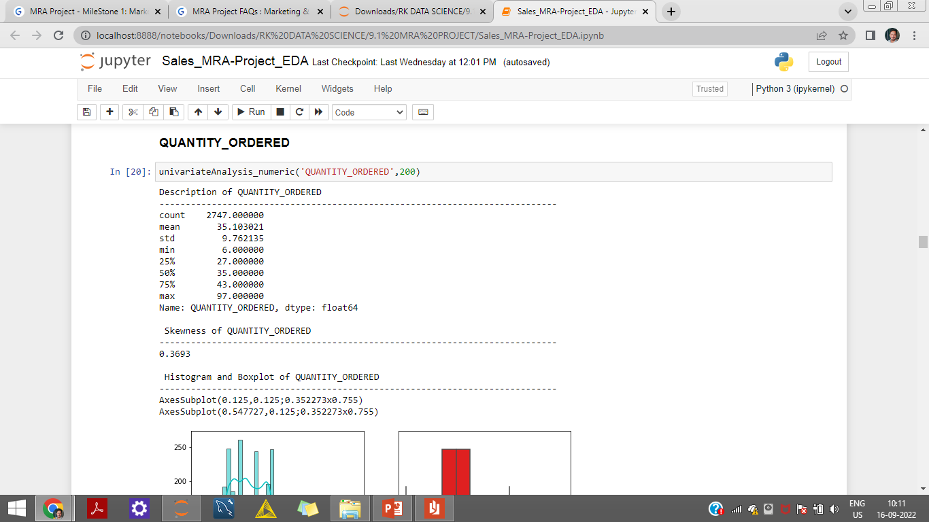
Univariate Analysis
EDA
Quantity Ordered
The variable Quantity Ordered is positive or Right Skewed.
The variable has few outliers present in the dataset.
More than 50% of quantity ordered lies between 27 to 43.

Slide 13
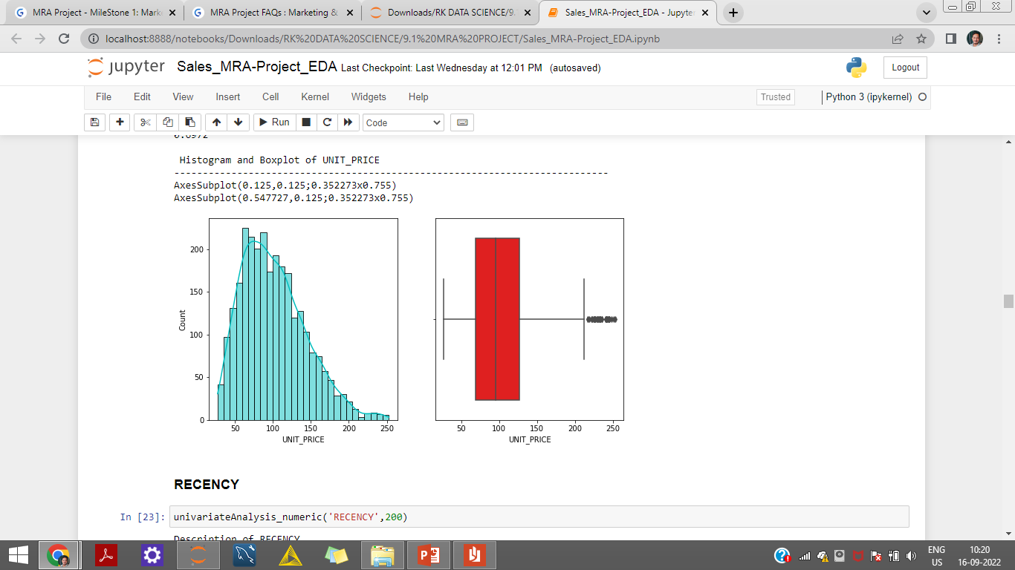
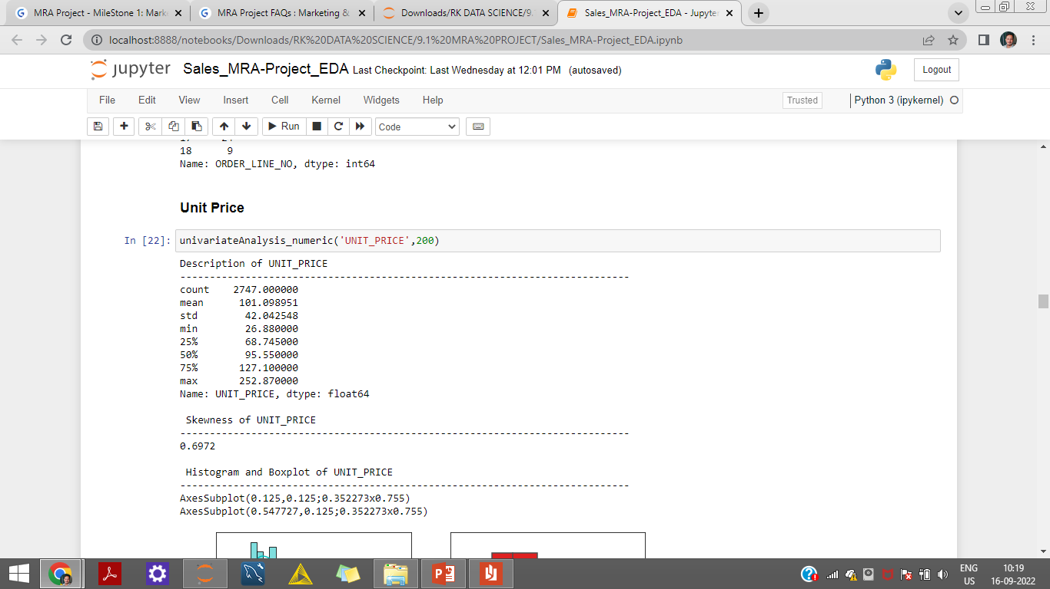
Univariate Analysis
Unit Price
The variable Quantity Ordered is positive or Right Skewed.
The variable has few outliers present above the upper range.

Slide 14
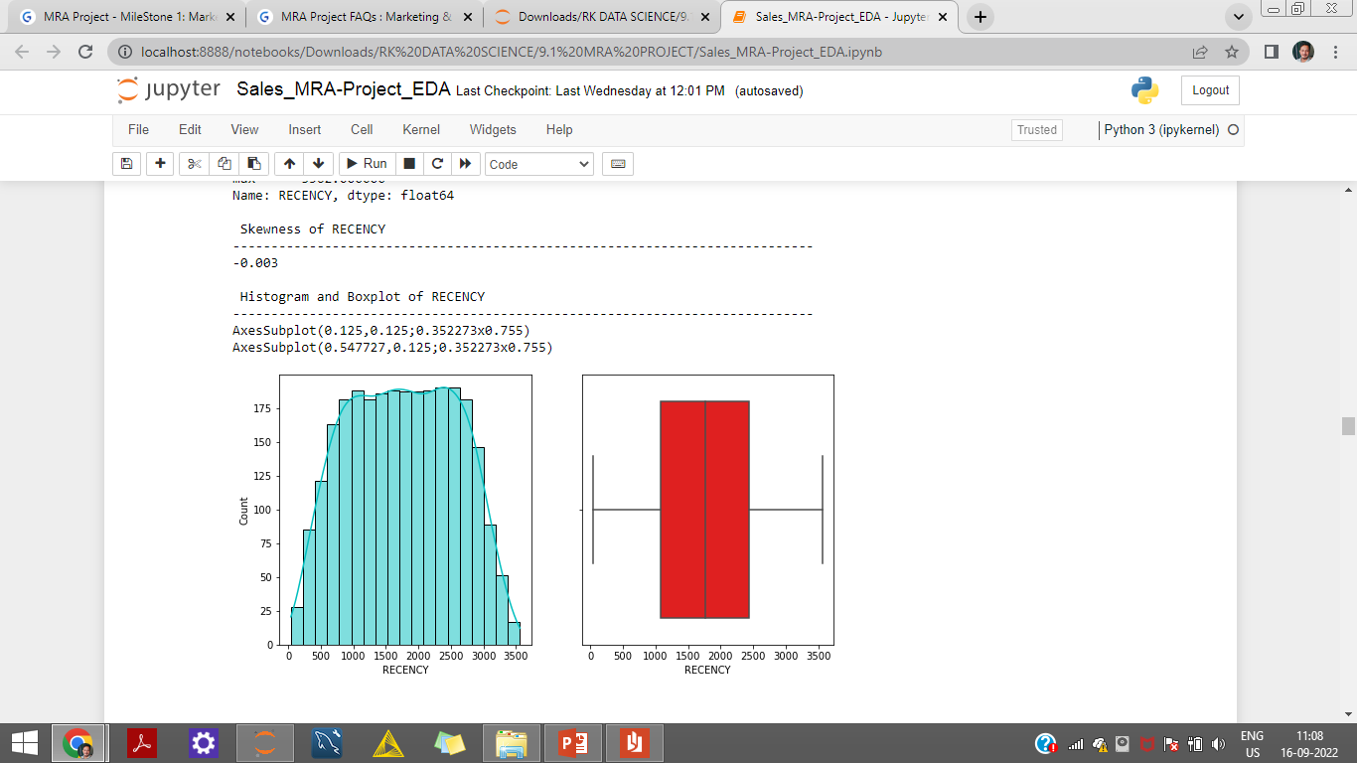
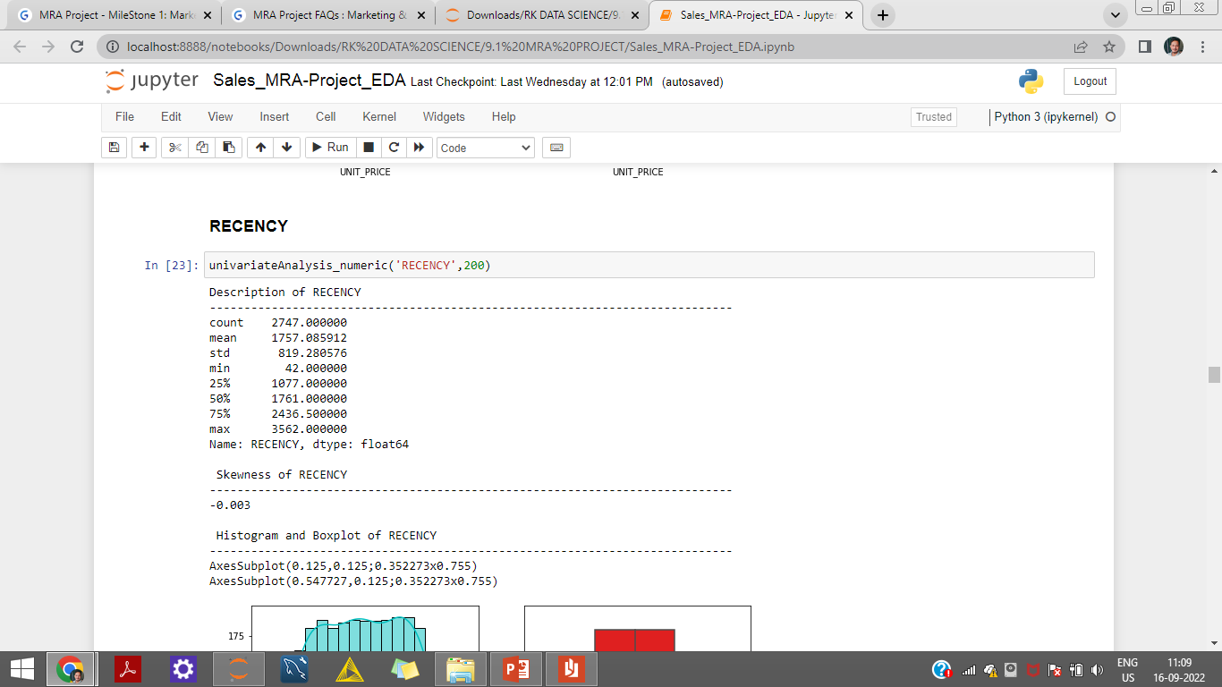
Univariate Analysis
Recency
The variable Recency is negative or Left Skewed.
The variable has no outliers present.

Slide 15
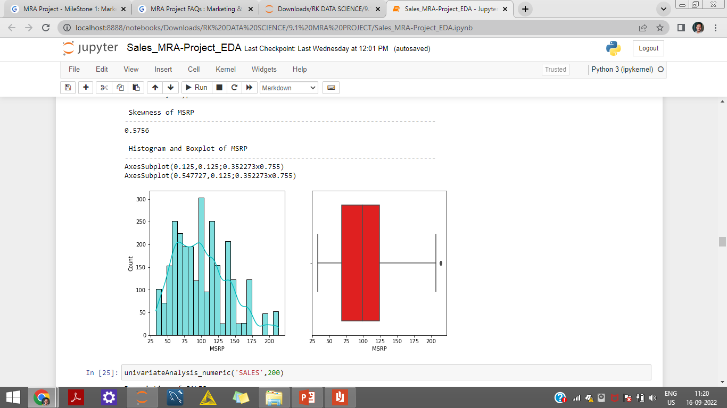
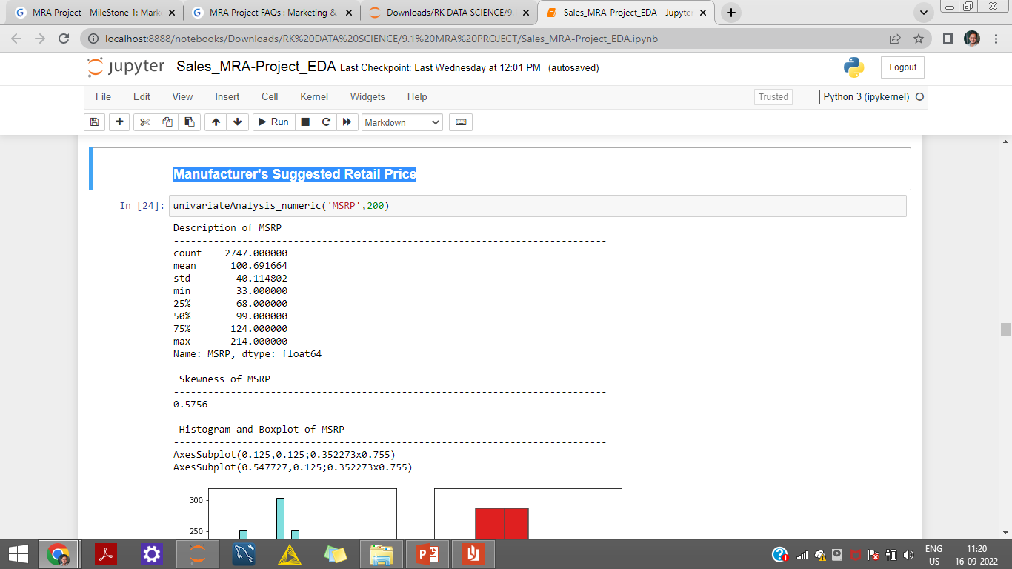
Univariate Analysis
Manufacturer's Suggested Retail Price (MSRP)
The variable MSRP is positive or Right Skewed.
The variable has an outlier present above the upper range.

Slide 16
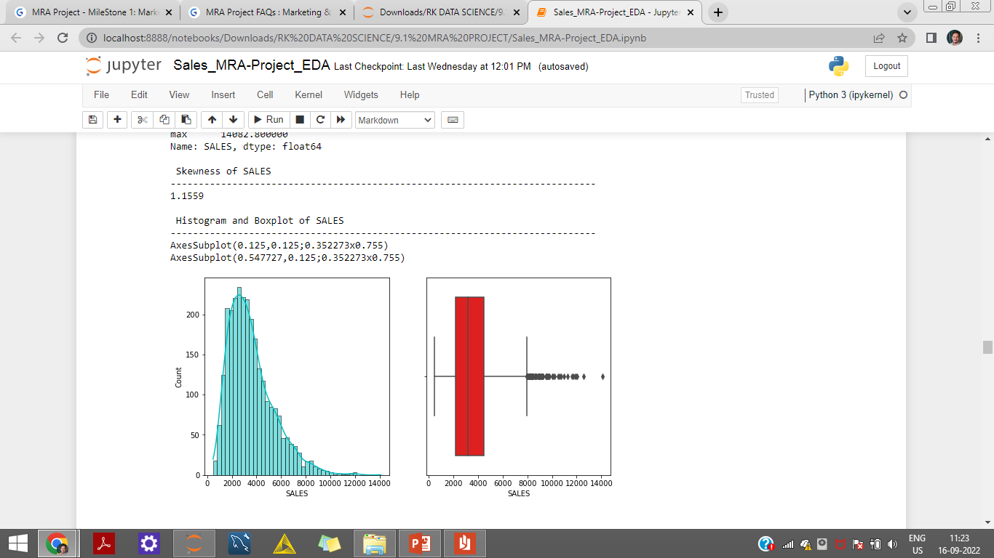
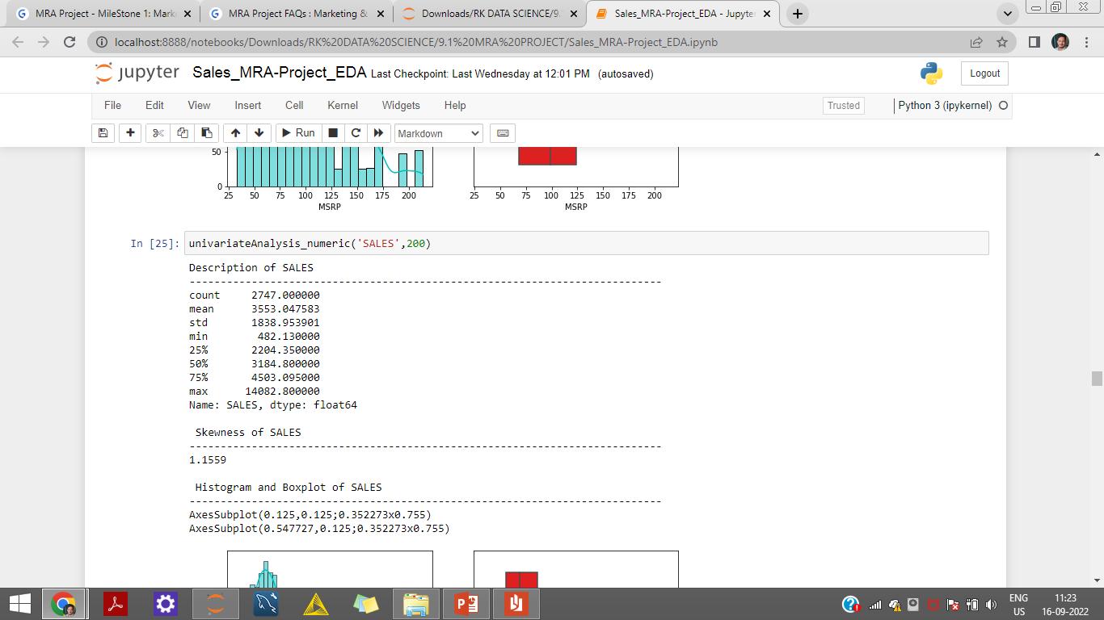
Univariate Analysis
Sales
The variable Sales is Highly positive or Highly Right Skewed.
The variable has many outlier present above the upper range.

Slide 17
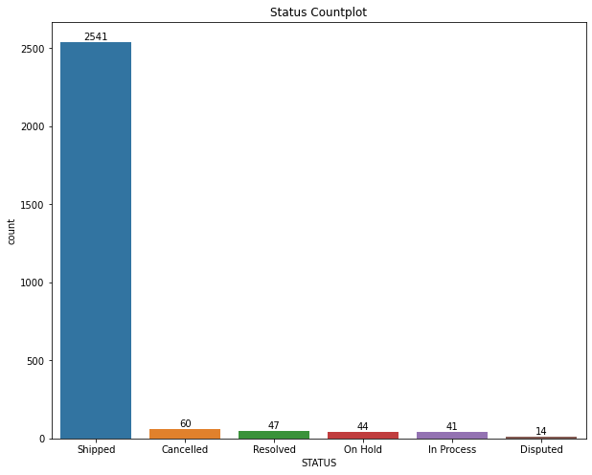
Univariate Analysis
Status
INFERENCE
The variable status has 6 different types of status.
‘Shipped’ being the most common Status.
‘Disputed’ being the least.

Slide 18
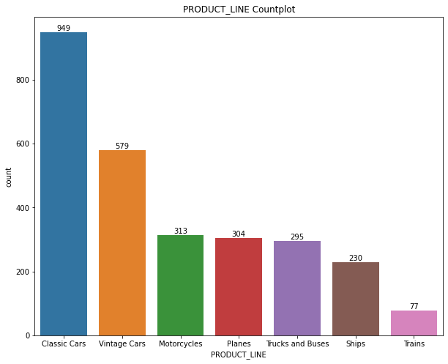
Univariate Analysis
Product line
INFERENCE
The variable status has 7 different types of status.
‘Classic Cars’ has the highest frequency followed by ‘Vintage Cars’
‘Trains’ being the least used product line followed by Ships.

Slide 19
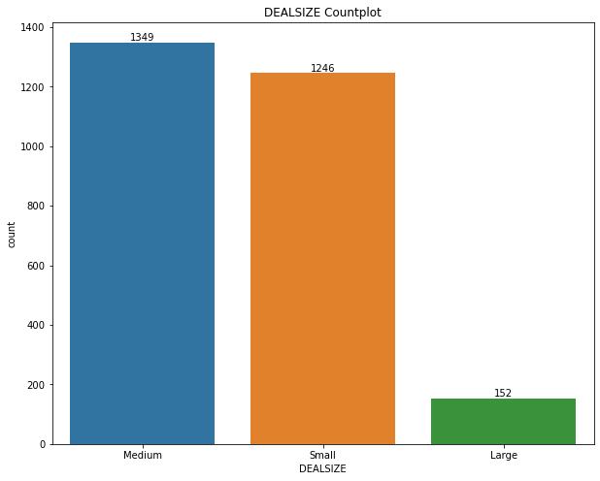
Univariate Analysis
Deal Size
INFERENCE
The variable Deal size has 3 different types of sizes.
Most of the deal size are ‘Medium’
‘Large’ being the least preferred deal size.

Slide 20
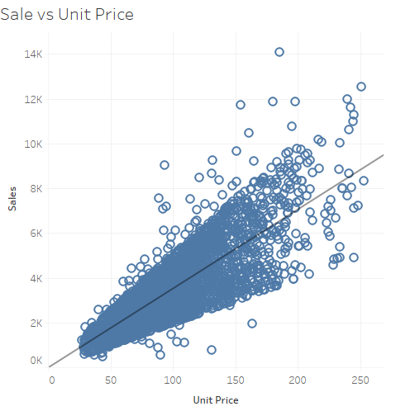
Bivariate Analysis
INFERENCE
The variable Sale and Unit Price have a Strong positive correlation.
The Trend line shows an increasing trend for Sales as the Unit Price increases.

Slide 21
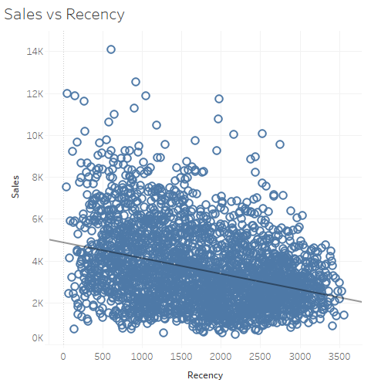
Bivariate Analysis
INFERENCE
The variable Sale and Recency have no correlation.
Cloud like pattern can be observed for correlation.
The Trend line shows an decreasing trend for Sales.

Slide 22
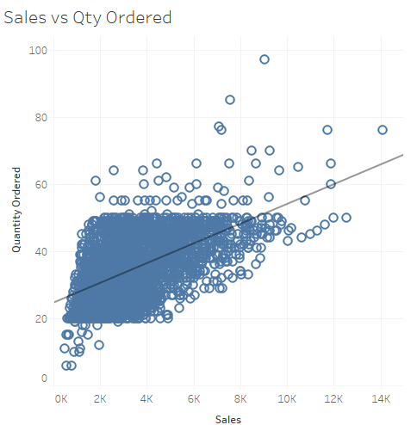
Bivariate Analysis
INFERENCE
The variable Sale and Quantity Ordered have Moderate positive correlation.
The Trend line shows an increasing trend for Sales as the quantity of orders increases.

Slide 23
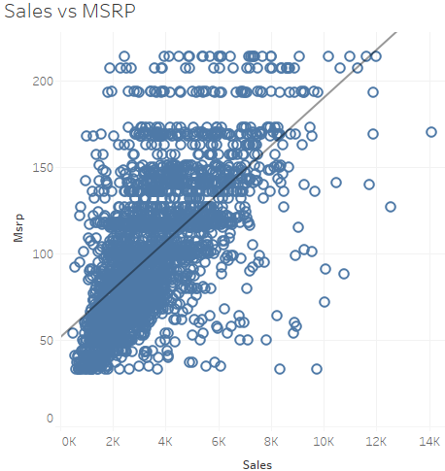
Bivariate Analysis
INFERENCE
The variable Sale and MSRP have Moderate positive correlation.
The Trend line shows an increasing trend for Sales as the MSRP increases.

Slide 24
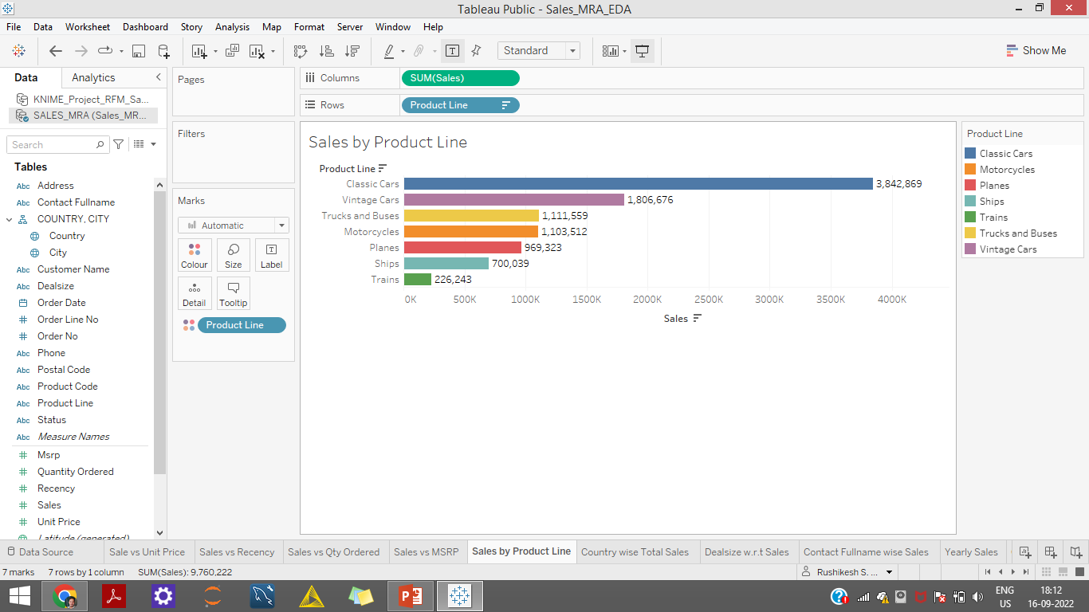
Bivariate Analysis
INFERENCE
The Product Line Classic Cars has garnered the maximum sales followed by Vintage Cars.
While Trucks-Buses and Motorcycles has done moderate sales
Planes, Ships and Trains have made low sales

Slide 25
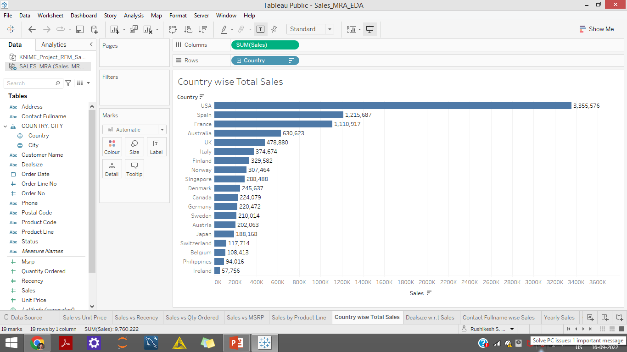
Bivariate Analysis
USA has highest sales followed by Spain and France
Ireland has the least sales followed by Philippines and Belgium

Slide 26
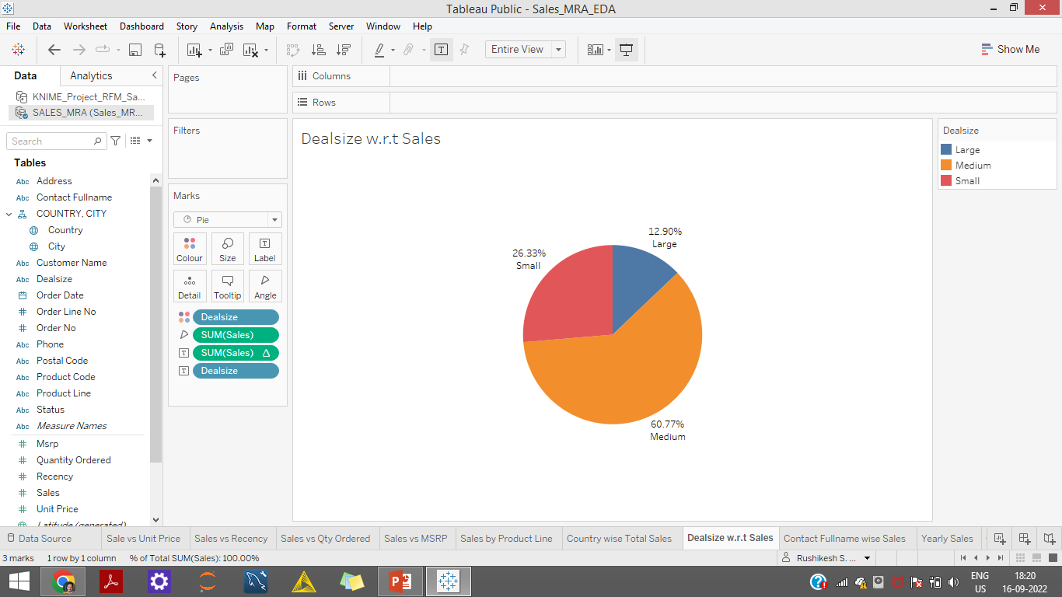
Bivariate Analysis
INFERENCE
The variable Deal size has 3 different types of sizes.
About 60% Sales have been made through ‘Medium’ deal size.
‘Small’ Deal size amount to about little more than 26% of Total Sales.
‘Large’ being the least preferred deal size with close to 13% of total Sales .

Slide 27
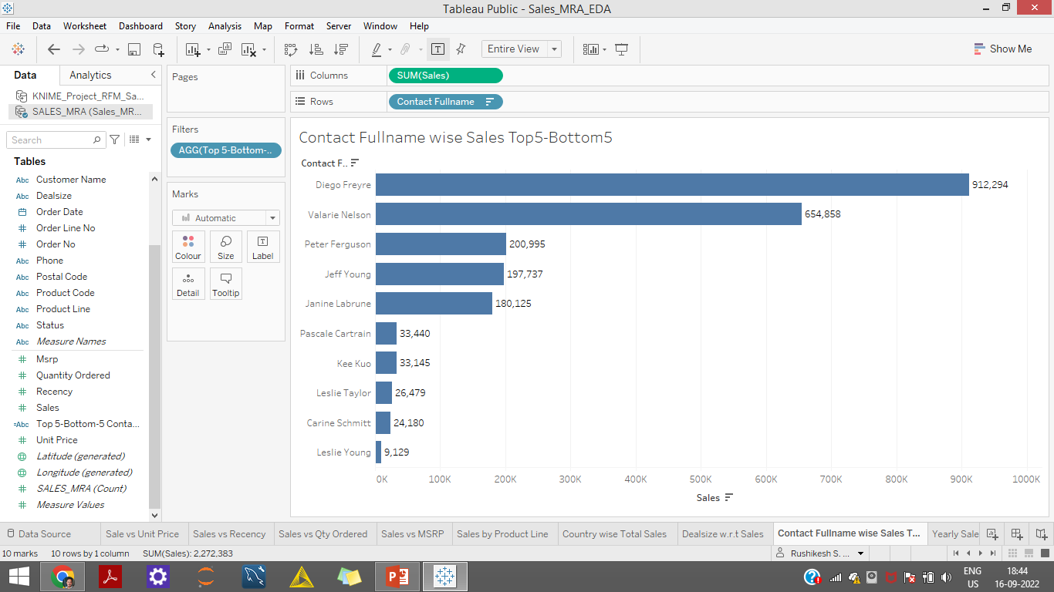
Bivariate Analysis

Slide 28
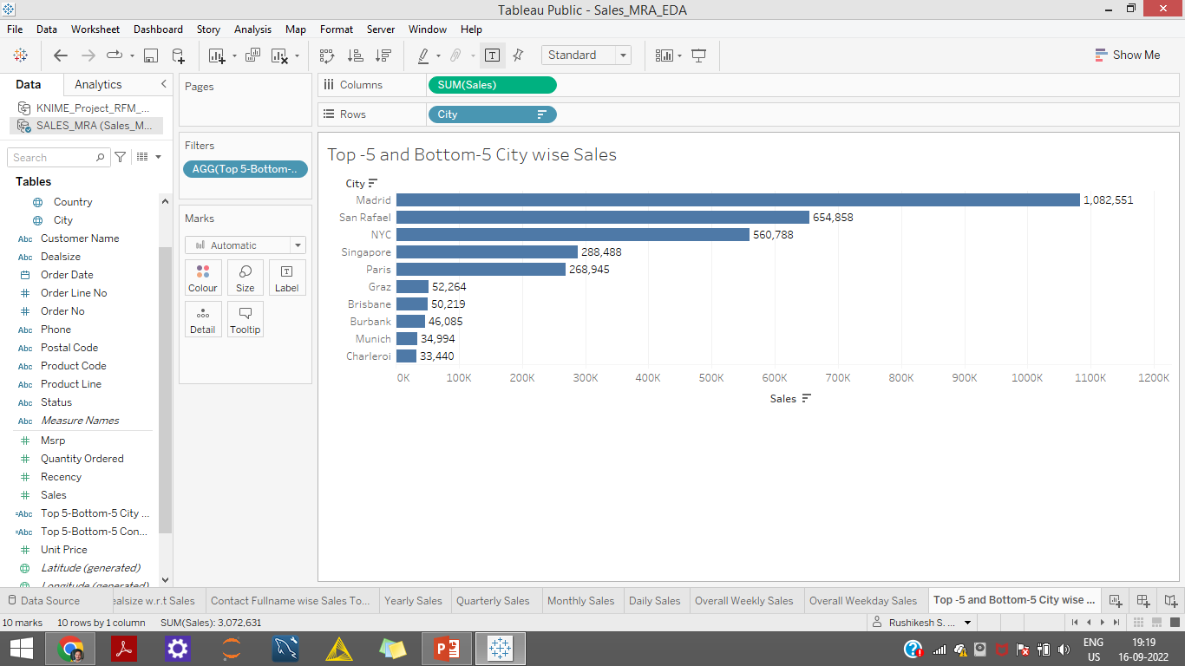
Bivariate Analysis

Slide 29
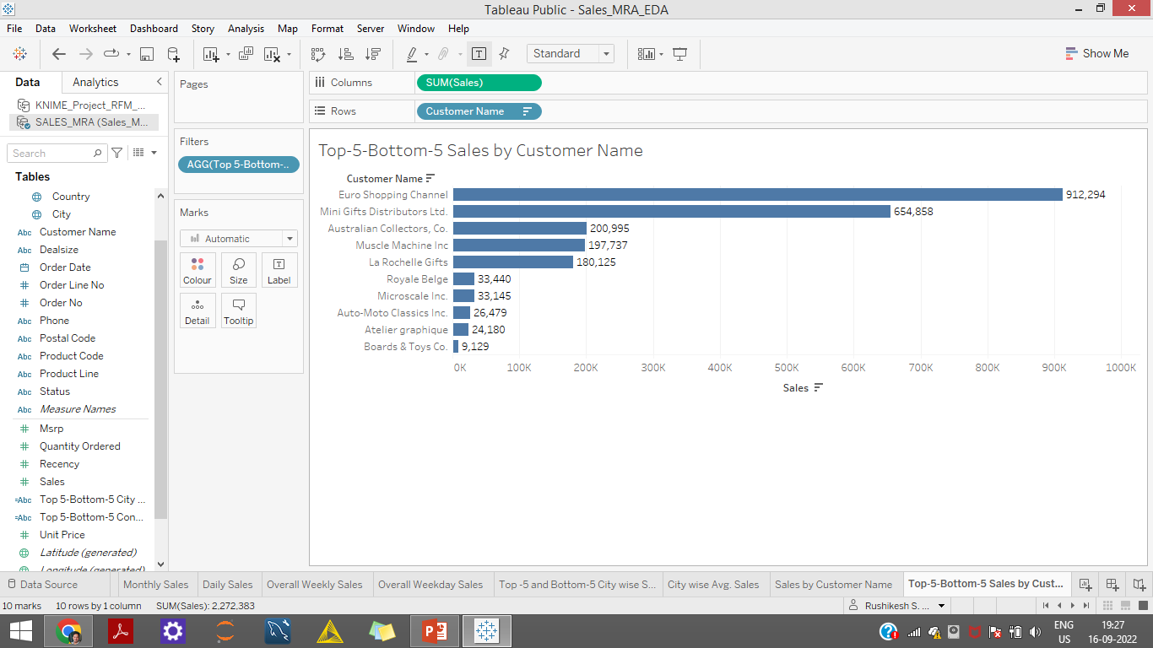
Bivariate Analysis

Slide 30
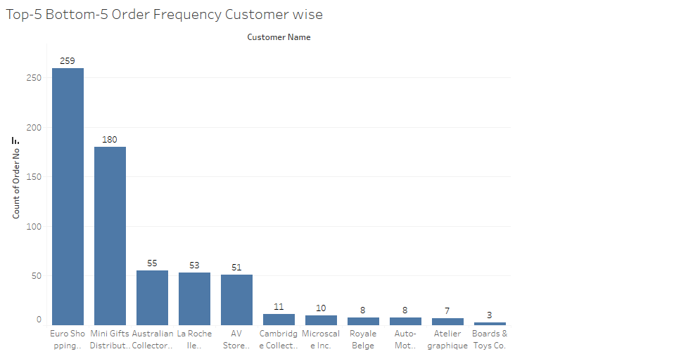
Bivariate Analysis

Slide 31
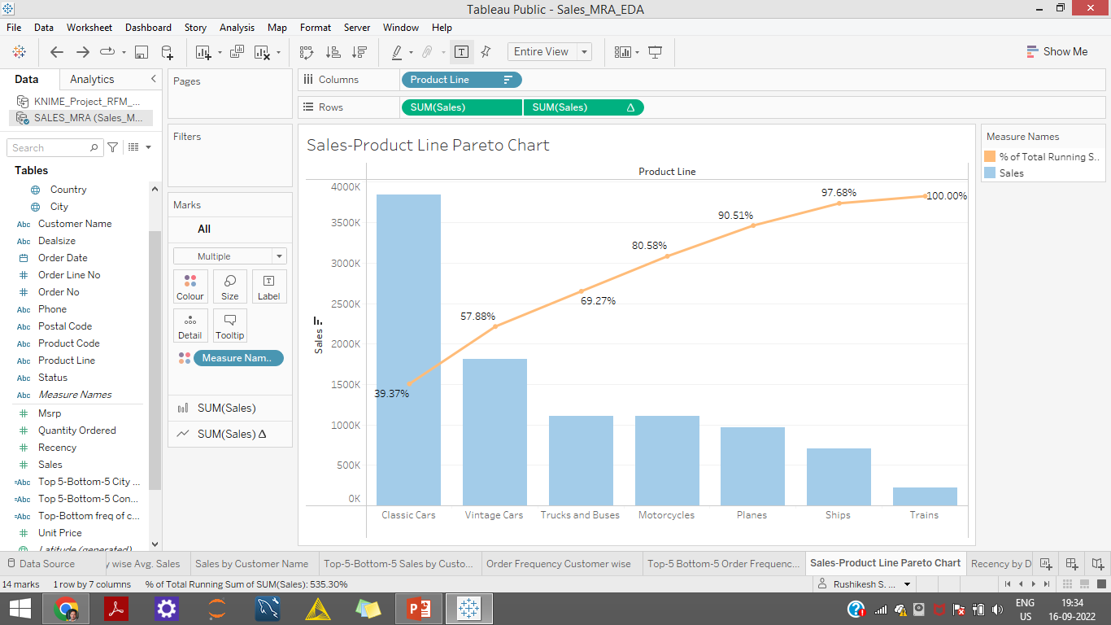
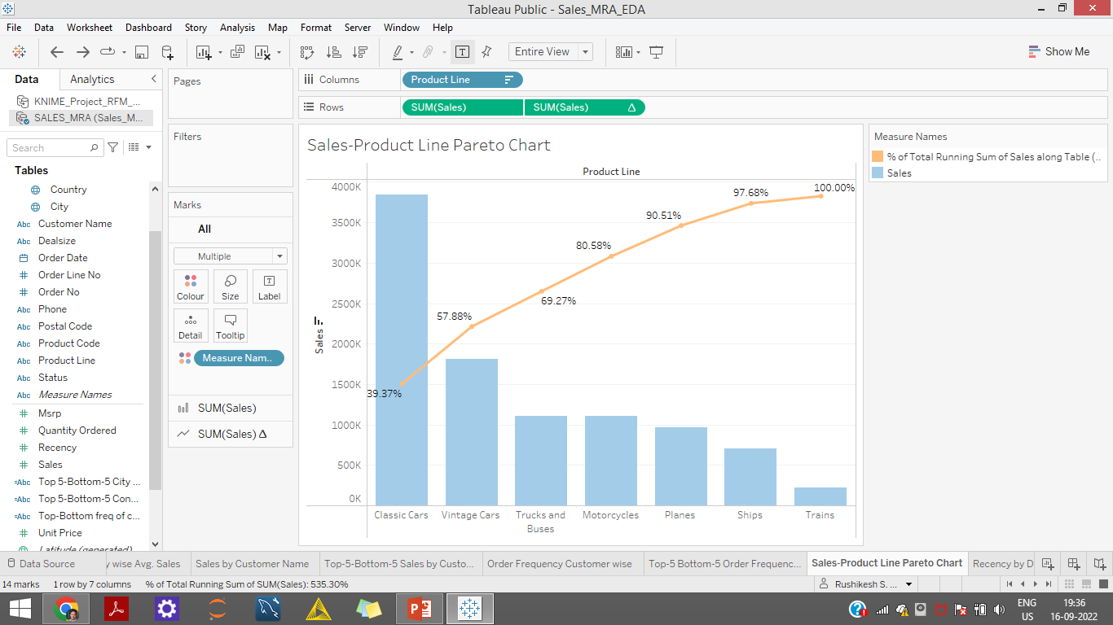
Bivariate Analysis
INFERENCE
Almost close to 70% of total sales have come through 3 product line namely
‘Classic Cars',
'Vintage Cars',
'Trucks and Buses’

Slide 32
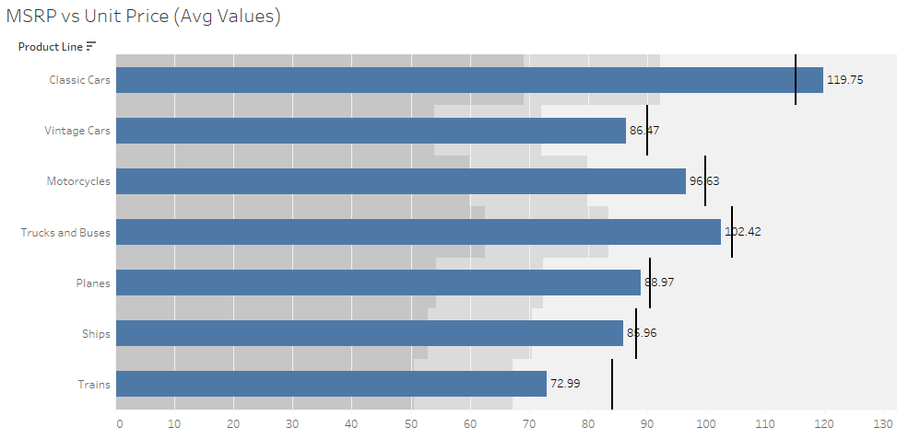
Bivariate Analysis
Except for ‘Classic Cars’ all other Product lines have avg. Unit price greater than avg. Manufacturer's Suggested Retail Price (MSRP)

Slide 33
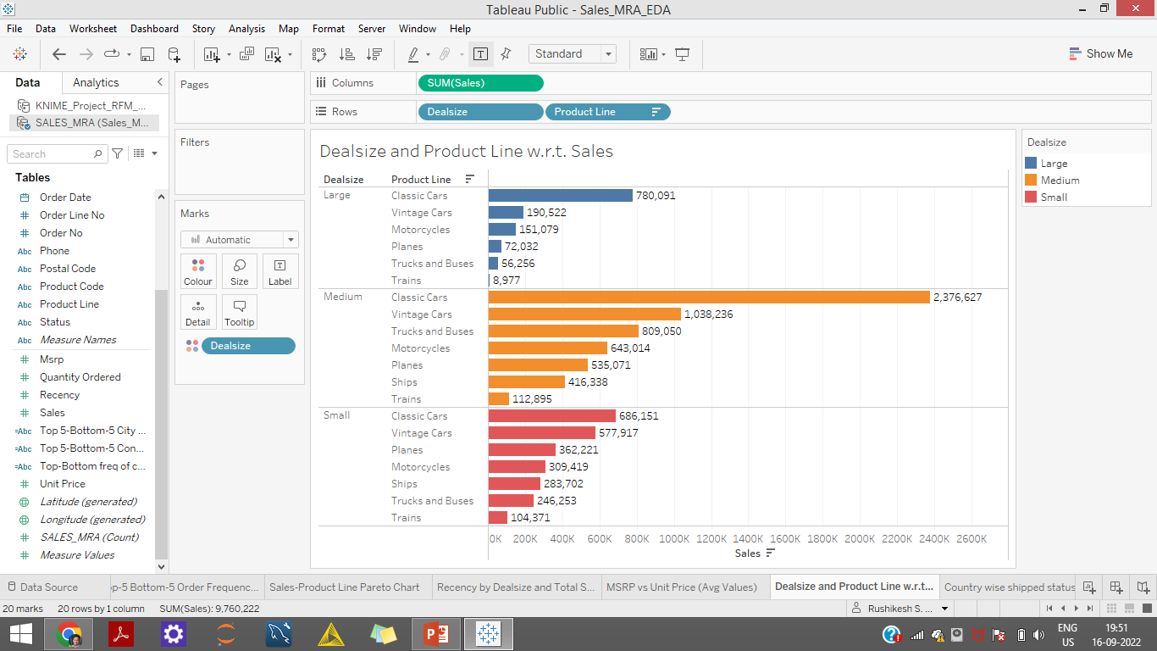
Bivariate Analysis

Slide 34
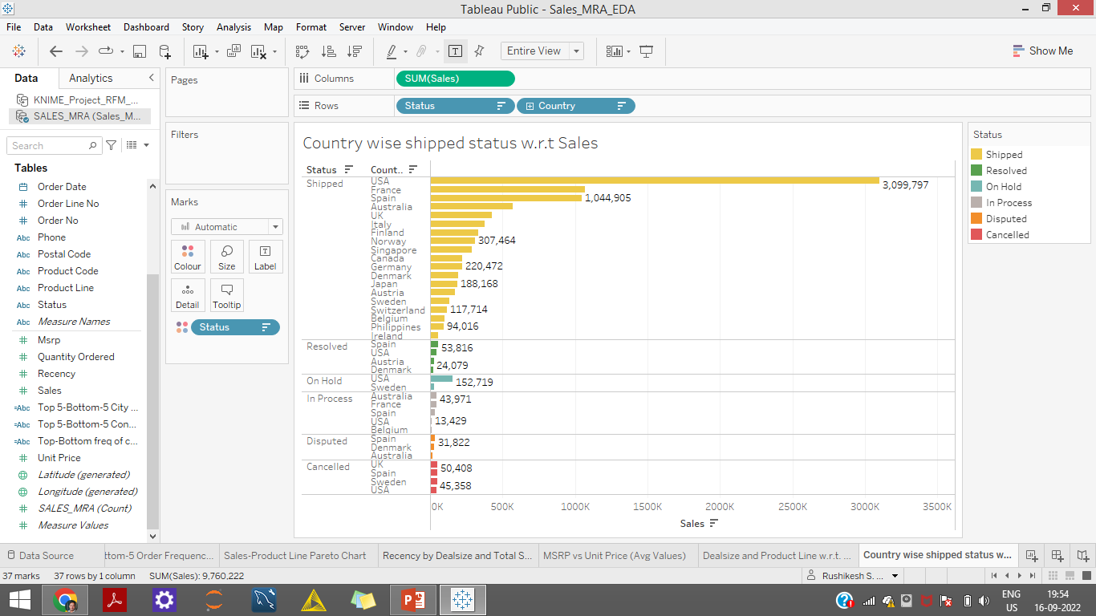
Bivariate Analysis

Slide 35
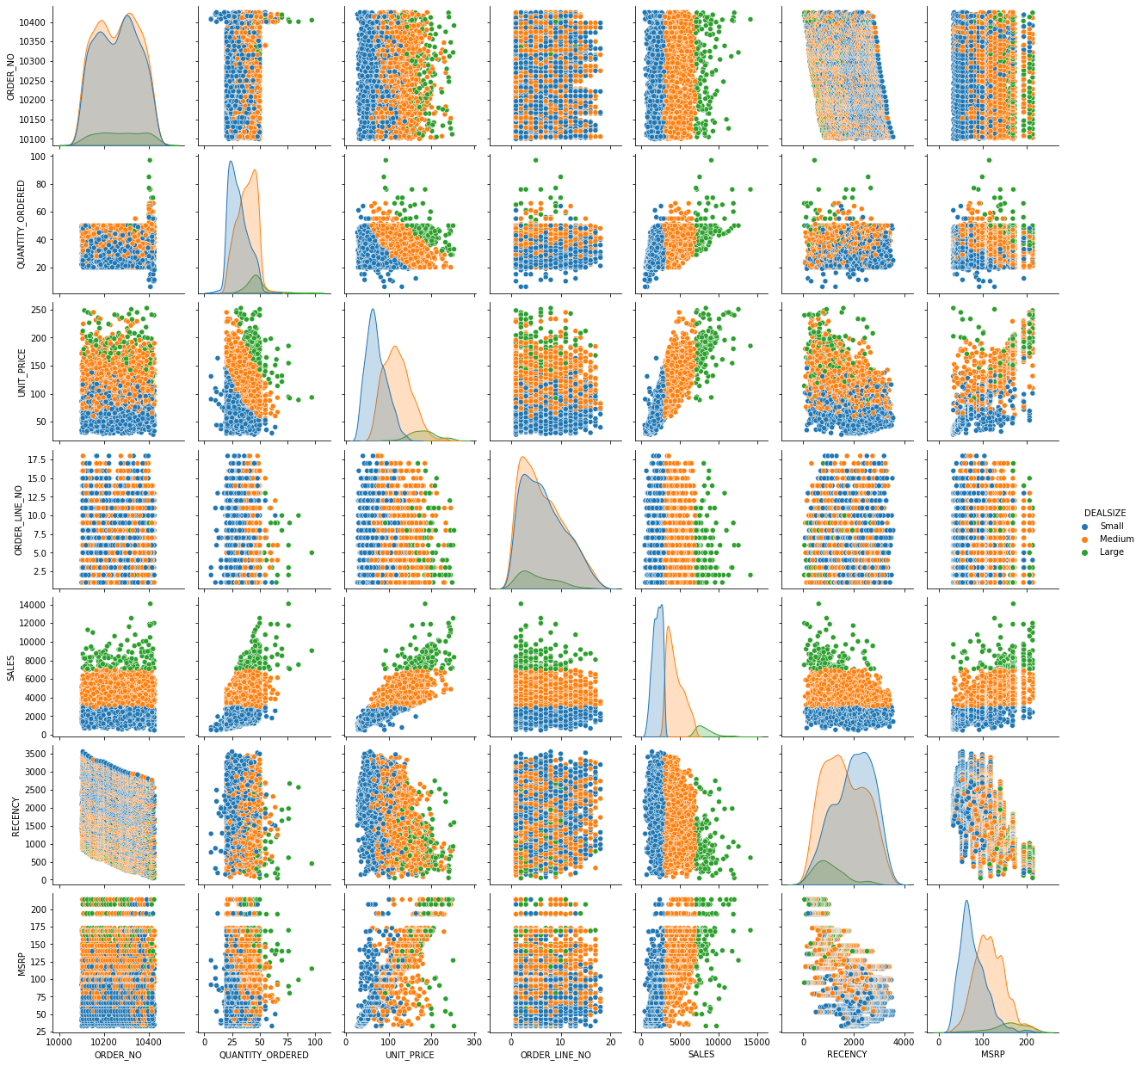
Multivariate Analysis-Pairplot
INFERENCE
Here we have found the pairwise relationship of the dataset.
Many variable seem to form cloud type pattern indicating no clear relationship.
We also have some strong positive and negative correlation amongst the variable
We have selected hue as deal size.

Slide 36
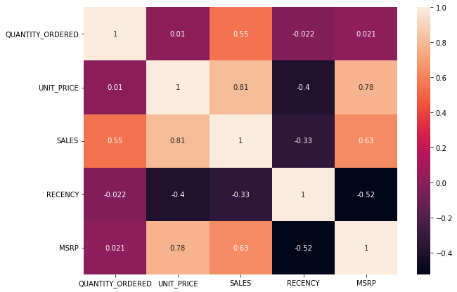
Correlation Heatmap
INFERENCE
There are some high correlation
Sales and Unit Price=0.81
MSRP and Unit price=0.78
Other Positive Correlation
Sales and Qty = 0.55
MSRP and Sales = 0.63
There are some negative correlation
Recency and MSRP = -0.52
Recency and Unit Price=-0.4
Sales and Recency = -0.33

Slide 37
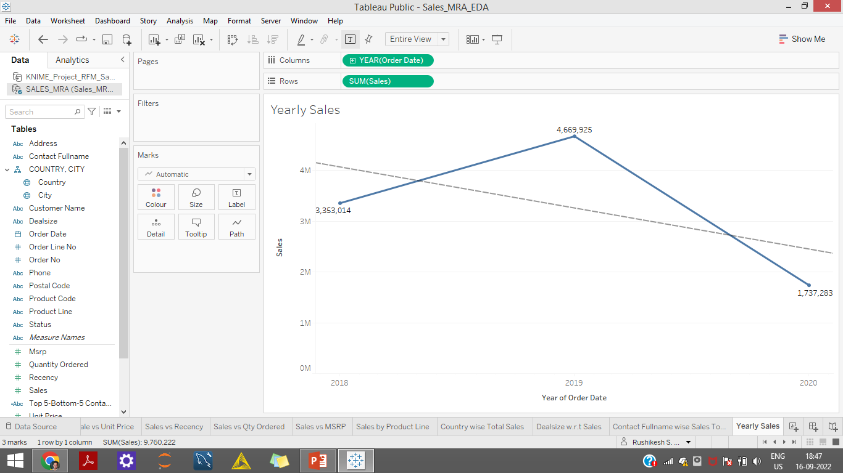
Yearly Trend
2019 has the highest sales, while 2020 has the least.
The overall trend is decreasing

Slide 38
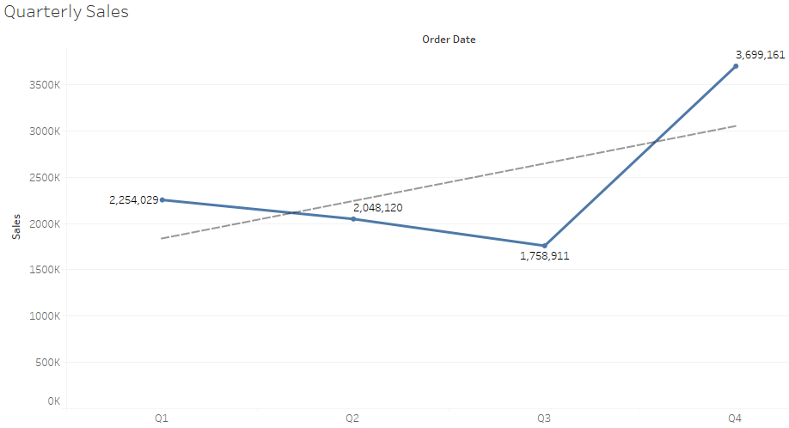
Quarterly Trend
Q4 has highest sales while Q3 performs poorly.
Q1 and Q2 are almost similar.

Slide 39
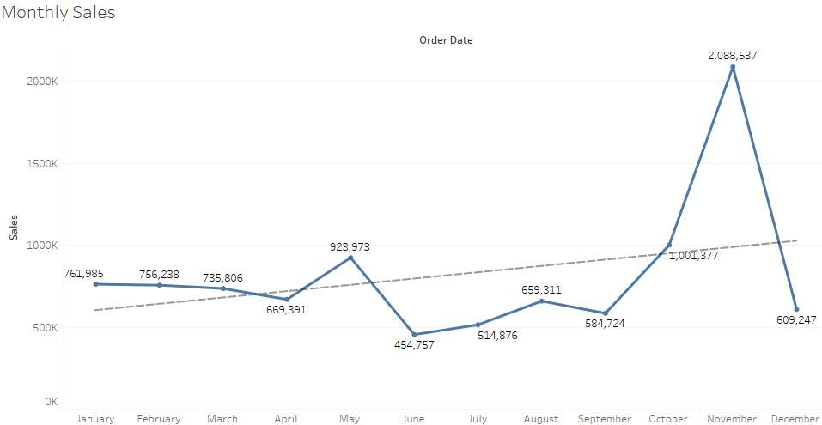
Monthly Trend
May, October and November seems to do well with Sales
Overall trend is increasing, with dip in Sales from June to September and Consistency for first 3 months can be observed.

Slide 40
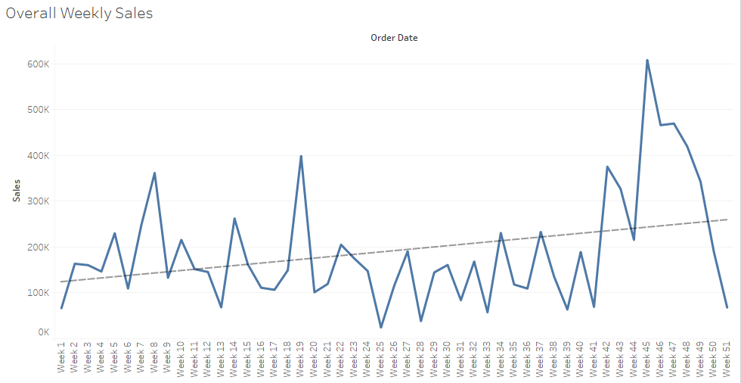
Weekly Trend
Overall trend is increasing, with dip in Sales from week 23 to week 41 September and an upsurge from at week 44 to week 46 can be observed.

Slide 41
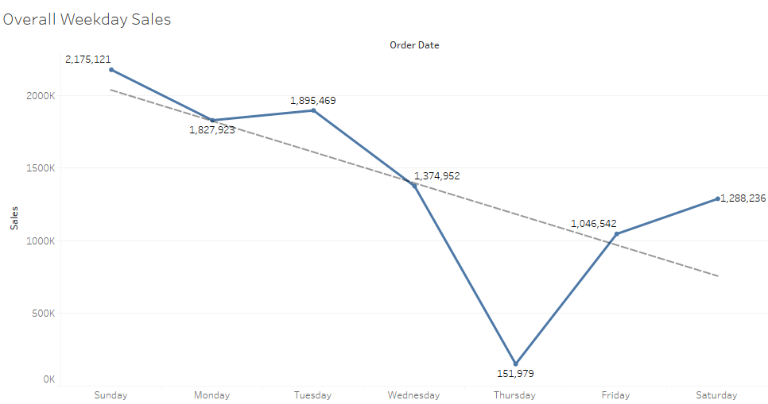
Weekday Trend
Sunday seems to bring the most sales while Thursday brings the least.
Overall trend is decreasing as the week proceeds.

Slide 42
EDA SUMMARY [INFERENCES]
About 60% Sales have been made through ‘Medium’ deal size. The Clear go to choice.
‘Shipped’ being the most common Status.
‘Classic Cars’ has the highest frequency followed by ‘Vintage Cars’ and hence also the sales.
Planes, Ships and Trains have made low sales, regular maintenance and checks keeps the parts in good condition
The variable Sale and Unit Price have a Strong positive correlation.
The year 2019 has the highest sales, while the year 2020 has the least. The pre Covid times times economy doing well.
Q4 has highest sales while Q3 performs poorly, whereas Q1 and Q2 are almost similar. Year end combined with festival season.
Months of May, October and November seems to do well with Sales. Summer and Winter breaks with festival and vacation time, family outings resulting in high use of personal and public transit.
Overall trend is increasing, with dip in Sales from week 23 to week 41 September and an upsurge from at week 44 to week 46 can be observed
Sunday seems to bring the most sales while Thursday brings the least. Being a Holiday people do take time for repair and maintenance works resulting in high orders for required automobile parts.
City wise Madrid has highest sales whereas Charleroi has the least. Madrid a city with high population and one of the most preferred tourist destinations.
Euro Shopping Channel has highest sales and order frequency while Boards and Toys Co. the least in terms of both.

Slide 43
EDA SUMMARY [INFERENCES]
Almost close to 70% of total sales have come through 3 product line namely 'Classic Cars', 'Vintage Cars', 'Trucks and Buses’
Except for ‘Classic Cars’ all other Product lines have avg. Unit price greater than avg. Manufacturer's Suggested Retail Price (MSRP),this can be the reason why Classic cars are doing great sales.
For all the different Deal Sizes 'Classic Cars‘ Tops the chart for sales while 'Trains’ sales lag.
Most Shipped To with high sales country is USA and Ireland is the least. USA given good population owns vehicles.
Most Resolved status by high Sales country is Spain while Denmark is the least in this category.
Most on hold status by high sales is for USA while the least being for Sweden.
Most of the Disputed status High sales are from Spain.
The cancelled status by sales is for Countries such as UK followed by Spain, Sweden and USA in that order.
Link for EDA in Tableau is attached below
https://public.tableau.com/app/profile/rushikesh.sunil.kalkar/viz/Sales_MRA_EDA/InactiveandChurnedLostCustomers?publish=yes

Slide 44
RFM
What is RFM?
RFM is a method used for analysing customer value. It is commonly used in database marketing and direct marketing and has received particular attention in retail and professional services industries.
RFM stands for the three dimensions:
Recency — How recently did the customer purchase?
Frequency — How often do they purchase?
Monetary Value — How much do they spend?

Slide 45
Customer Segmentation Using RFM Analysis
For Customer Segmentation using RFM Analysis, we have used the KNIME (Konstanz Information Miner) Analytics Platform
Before importing data to KNIME we used Python and Tableau to clean and perform EDA
The Packages used in Python were Numpy , Pandas ,Matplotlib and Seaborn
The Segmentation is done into 4 segmenst-Bin1,Bin2,Bin3,Bin4
For Recency Bin1 is Highest as lower the Recency metric higher is the Recency and Bin4 is lowest.
For Frequency and Monetary Bin4 is highest and Bin1 is the lowest.
Further the Bins have been assigned RFM values ranging from 1 to 4 and combined to obtain a RFM score

Slide 46
Customer Segmentation Using RFM Analysis
As per the RFM score we segment the customers into different categories
Best Customers-RFM Score-444-who bought most recently, most often, and are heavy spenders. Reward these customers.
Loyal Customers-RFM score (421 to 443)-recent customers with average frequency and who spent a good amount..
New Customers-RFM score (411 to 414)-customers who have a high overall RFM score but are not frequent shoppers
At Risk Customers-RFM score(311 to 344)-customers who purchased often and spent big amounts, but haven’t purchased recently
Almost Lost Customer -RFM score(211 to 244)-Customers on the verge of getting into Lost customer zone as they haven’t purchased in a while for now,
Lost Customer-RFM score(112 to 144)-Customers with very low Recency who haven’t purchased for a long time.
Inactive Customer-RFM score(111)-Low-scoring customers are the least promising prospects in your database. They don’t have a significant purchase history with your company and there have been no recent interactions

Slide 47
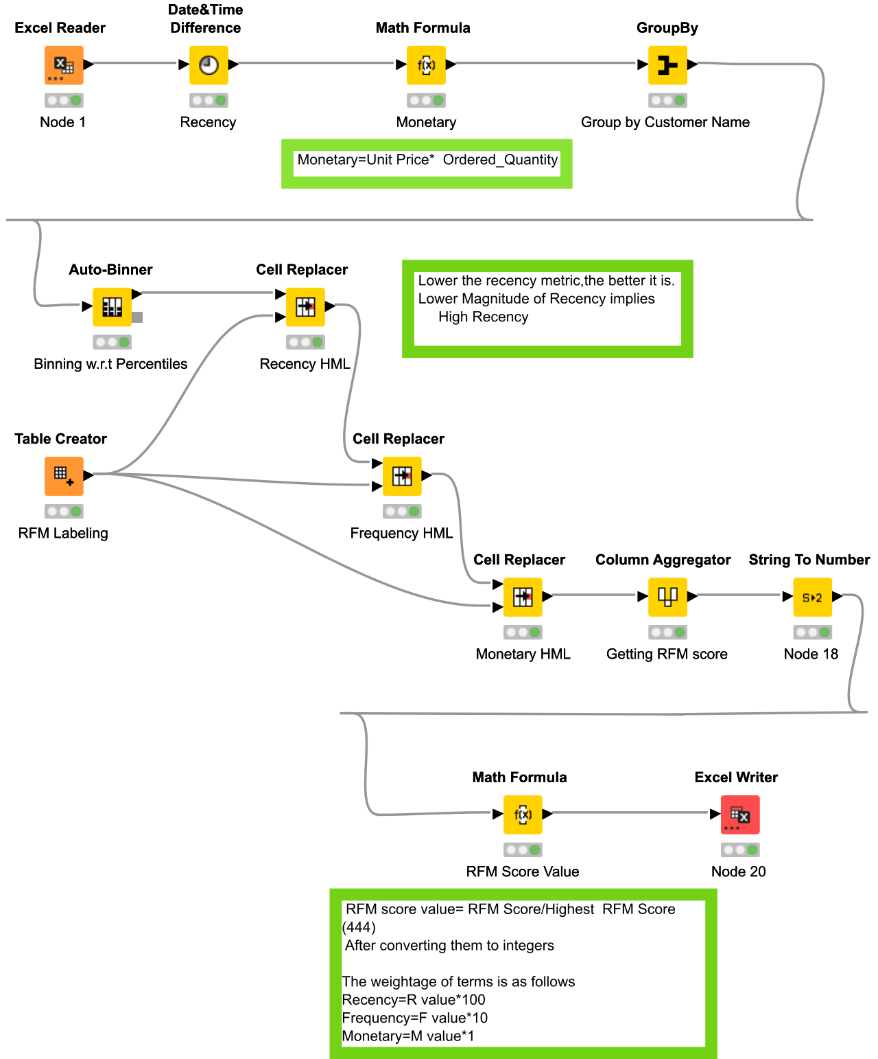
RFM KNIME-Workflow

Slide 48
RFM KNIME-Workflow
The steps involved in the KNIME workflow are as follows
Step1-Reading the data through excel reader (Node-1)
Step2-Creating a node for Recency with searching and drag dropping ‘Date Time Difference’ from Node repository and configuring it fixed date of "01-06-2020“ and base column being “ORDER_DATE”.
Step 3- Creating a node for ‘Monetary’ (same as sales) using ‘Math Formula’ where we give it an expression to perform an arithmetic operation x*y i.e. ‘Unit Price * Quantity Ordered’.
Step4-Using a group by node to group our data by Customer Name
Step 5-Using a Auto - Binner node to create 4 Bins for 4 segments using Quantiles as 0.0,0.25,0.50,0.75,1
Step 6- We use a ‘Table-Creator’ for numbering the Bin in the required order for RFM analysis
Step 7-Using Cell replacer and Binning the Recency, For Recency Bin1 is Highest as lower the Recency metric higher is the Recency and Bin4 is lowest.
Step8-Using Cell Replacer for Frequency.
Step 9-Using Cell Replacer for Monetary.
Step 10- Creating RFM score using Column Aggregator and Concatenating the RFM values
Step 11- Converting RFM score to integer

Slide 49
Step 12- Creating RFM score value
RFM score value= RFM Score/Highest RFM Score (444)
After converting them to integers
The weightage of terms is as follows
Recency=R value*100
Frequency=F value*10
Monetary=M value*1
RFM score value of 1 being the highest and 0.25 being lowest.

Slide 50
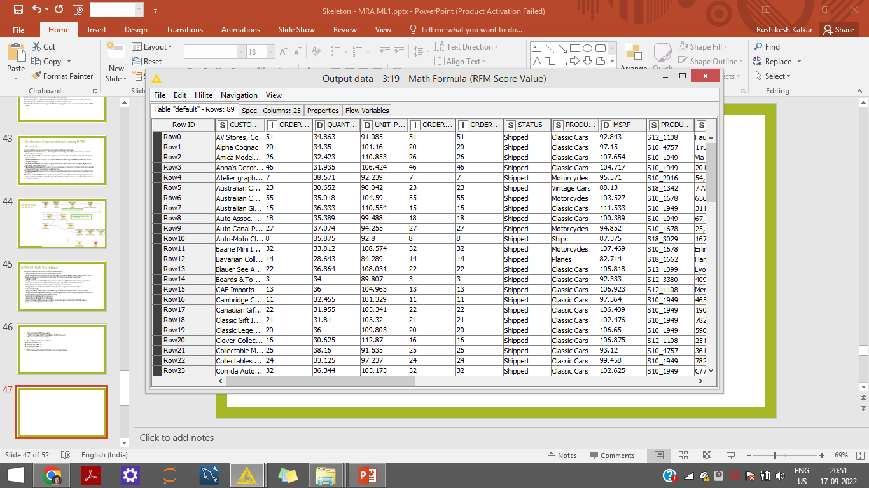
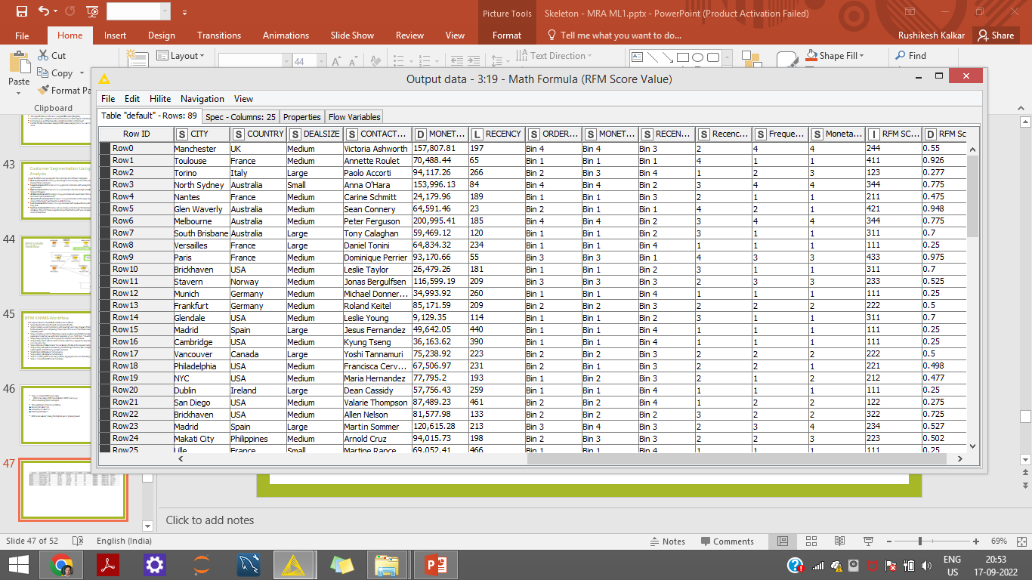
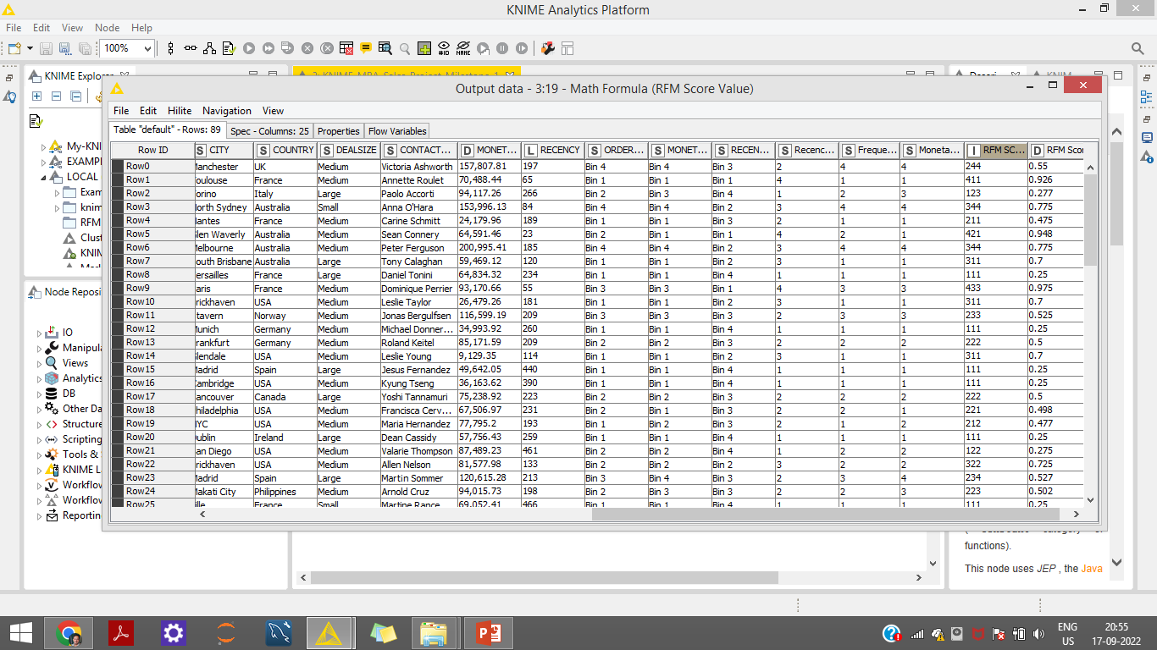
RFM Output Table Head

Slide 51
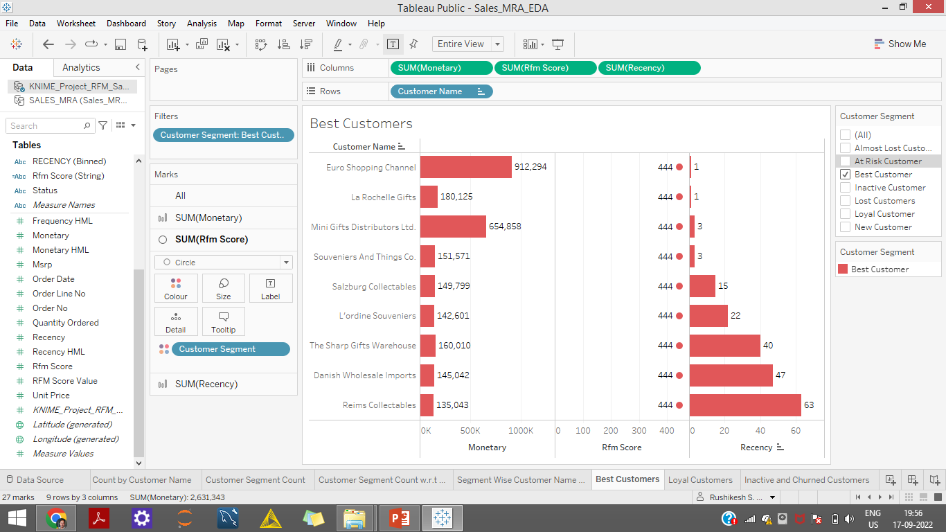
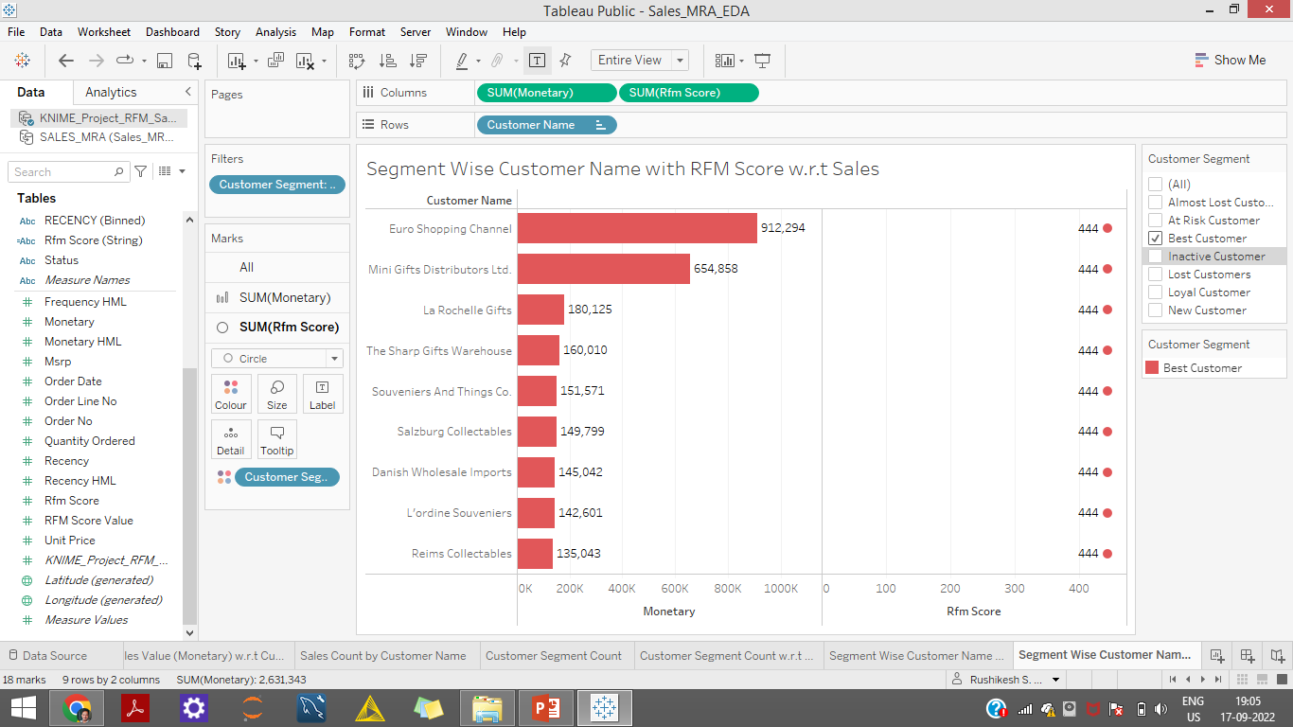
Inferences from RFM Analysis and identified segments
Top 5 Best Customers
These customers have proven to have a higher willingness to pay, so don't use discount pricing to generate incremental sales. Instead, focus on value added offers through product recommendations based on previous purchases

Slide 52
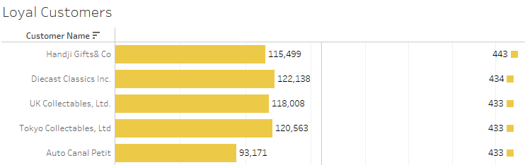
Inferences from RFM Analysis and identified segments
Top 5 Loyal Customers
We can consider rewarding these customers with Free Shipping or other like benefits to move them up to Best Customers segment

Slide 53
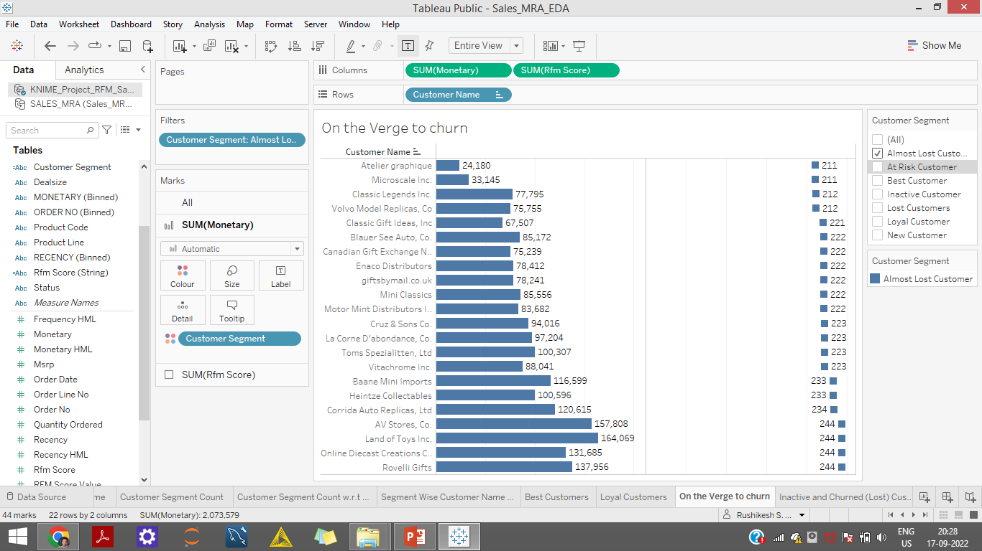
Inferences from RFM Analysis and identified segments
Customers on the Verge of Churning
These are on the verge of being lost & hence needs high & immediate attention

Slide 54

Inferences from RFM Analysis and identified segments
Lost-Inactive Customers
This category is very difficult to bring back & minimal efforts and resources should be channelled towards them. Instead companies can understand from their experiences about areas to improve on.

Slide 55

Inferences from RFM Analysis and identified segments
New Customers
Recent users have started purchasing recently & hence marketing strategy needs to be planned carefully to prevent their drop out and increase the sales.

